Slide 1



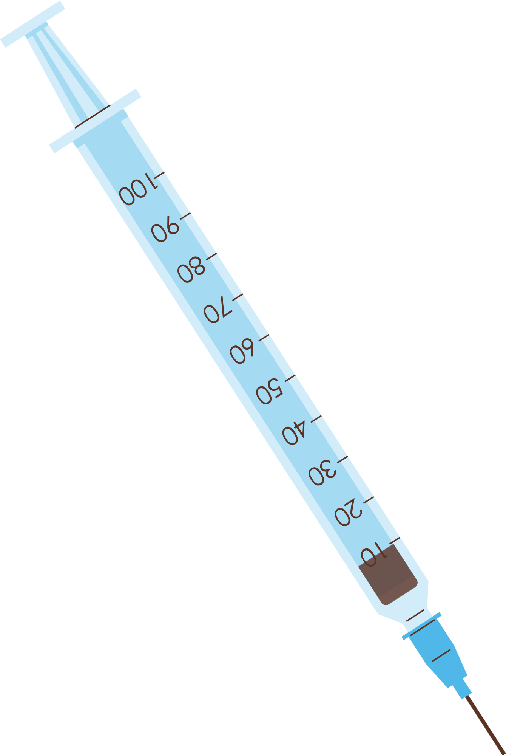



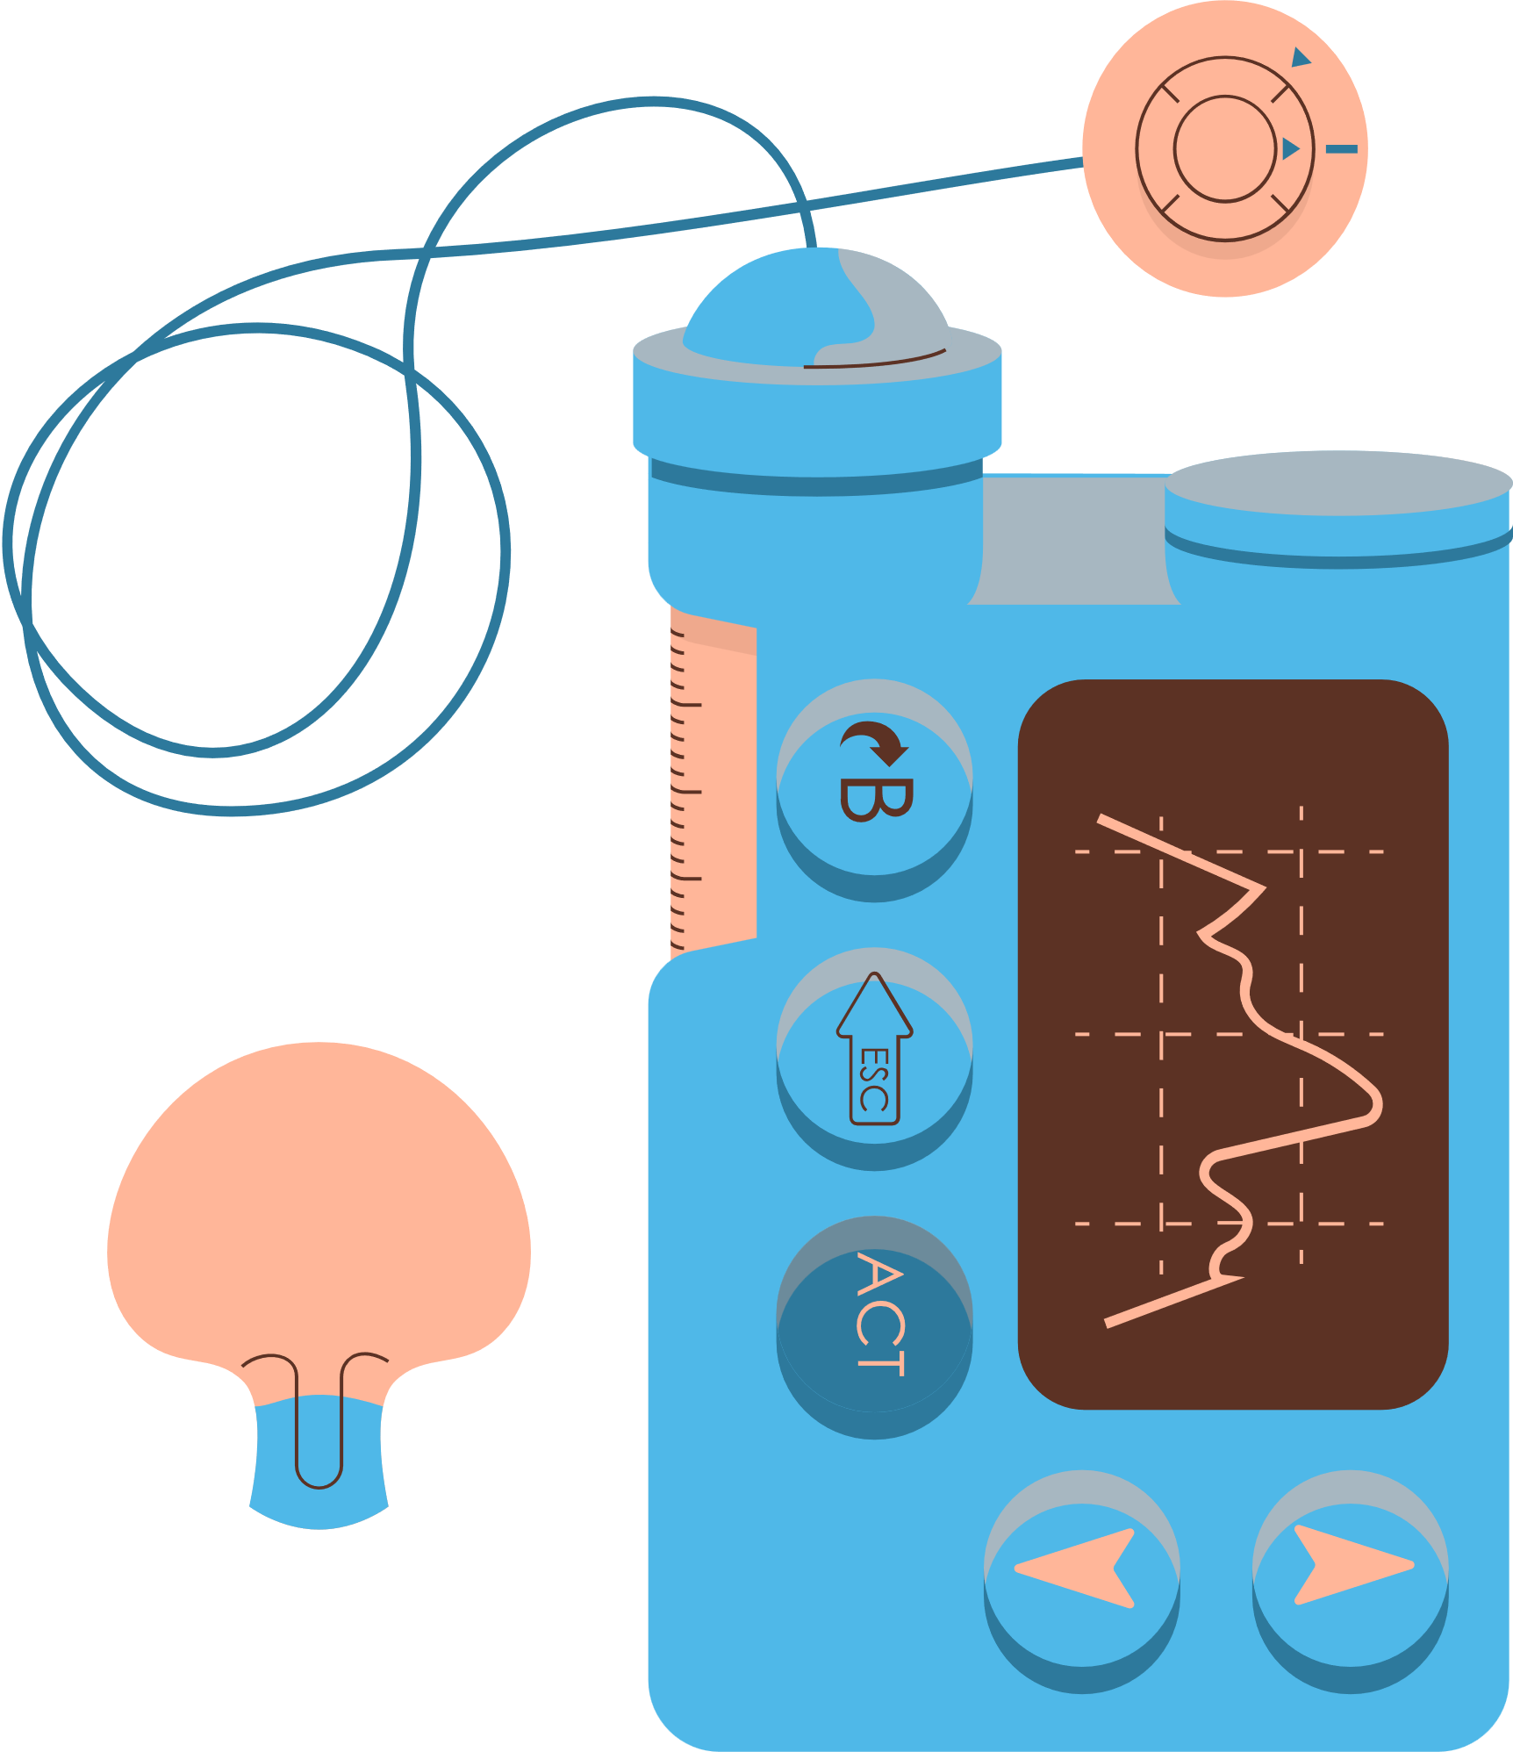
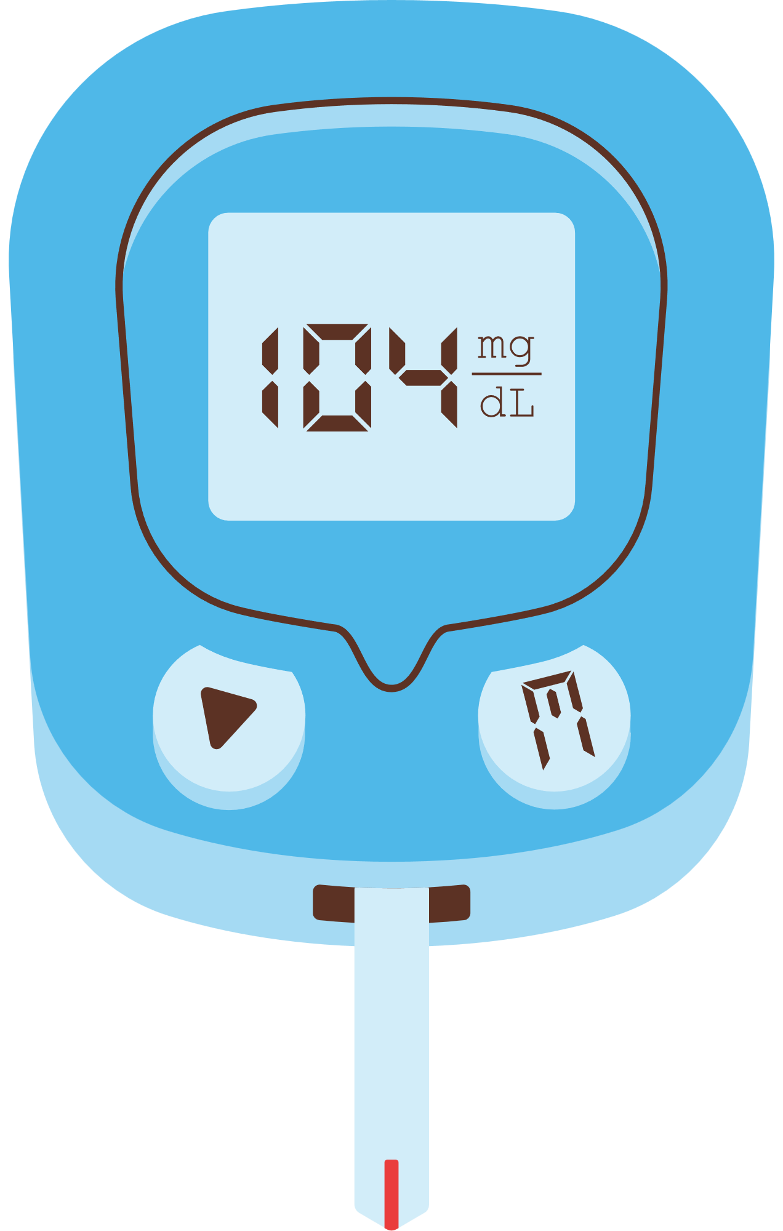

Created by: Steve Ramasamy
HEART ATTACK RISK ASSESSMENT USING MACHINE LEARNING MODEL

Slide 2

The Project Aim
To develop a Heart Attack Risk Assessment system using machine learning techniques.
This system will predict an individual's risk of experiencing a heart attack based on various health parameters and lifestyle factors.

Slide 3

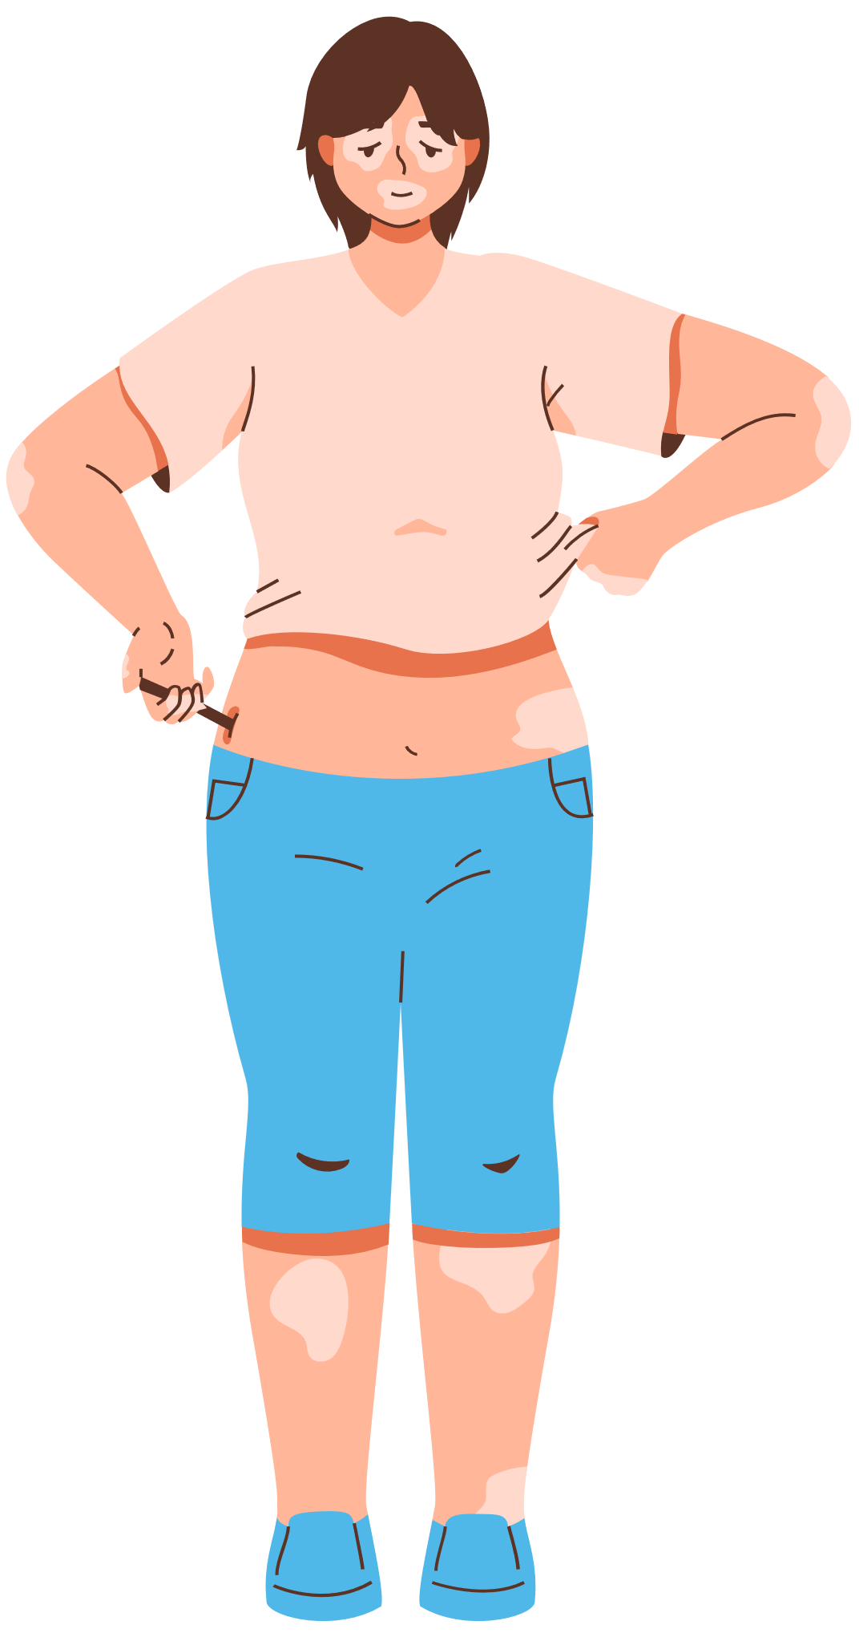
WHAT IS HEART ATTACK?
A HEART ATTACK USUALLY OCCURS WHEN A BLOOD CLOT BLOCKS BLOOD FLOW TO THE HEART.

Slide 4
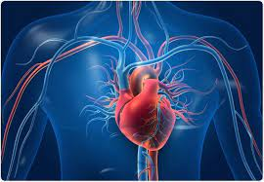
PRIMARY FACTORS CONTRIBUTING TO A HIGHER RISK OF HEART ATTACK
High BlooD PRESSURE (HYPERTENSION): ELEVATED BLOOD PRESSURE STRAINS THE HEART AND ARTERIES, INCREASING THE RISK OF HEART DISEASE AND HEART ATTACKS.
HIGH CHOLESTEROL (HYPERCHOLESTEROLEMIA): ELEVATED LEVELS OF LDL ("BAD") CHOLESTEROL CAN LEAD TO THE ACCUMULATION OF PLAQUE IN THE ARTERIES, RESTRICTING BLOOD FLOW AND RAISING THE RISK OF A HEART
SMOKING AND TOBACCO USE: SMOKING DAMAGES BLOOD VESSELS, RAISES BLOOD PRESSURE, AND PROMOTES THE BUILDUP OF FATTY SUBSTANCES IN THE ARTERIES, SIGNIFICANTLY INCREASING THE LIKELIHOOD OF A HEART ATTACK.
DIABETES MELLITUS: DIABETES CAN DAMAGE BLOOD VESSELS AND NERVES, CONTRIBUTING TO HEART DISEASE AND RAISING THE RISK OF HEART ATTACKS DUE TO ASSOCIATED COMPLICATIONS.
UNHEALTHY LIFESTYLE (POOR DIET AND PHYSICAL INACTIVITY): POOR DIETARY HABITS HIGH IN UNHEALTHY FATS, SALT, AND SUGAR, ALONG WITH A LACK OF PHYSICAL ACTIVITY, CONTRIBUTE TO OBESITY AND HIGHER RISKS OF HEART DISEASE AND HEART ATTACKS.

Slide 5

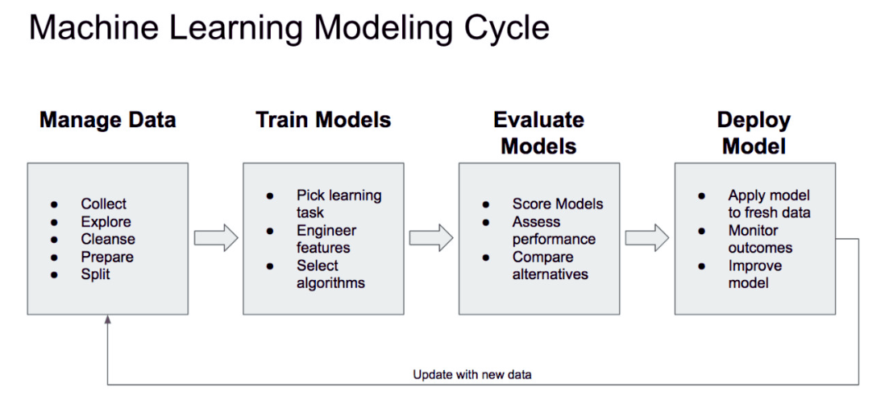


Slide 6
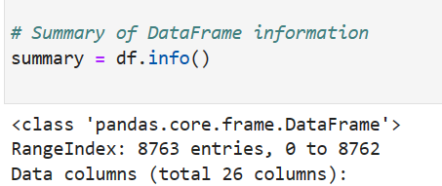
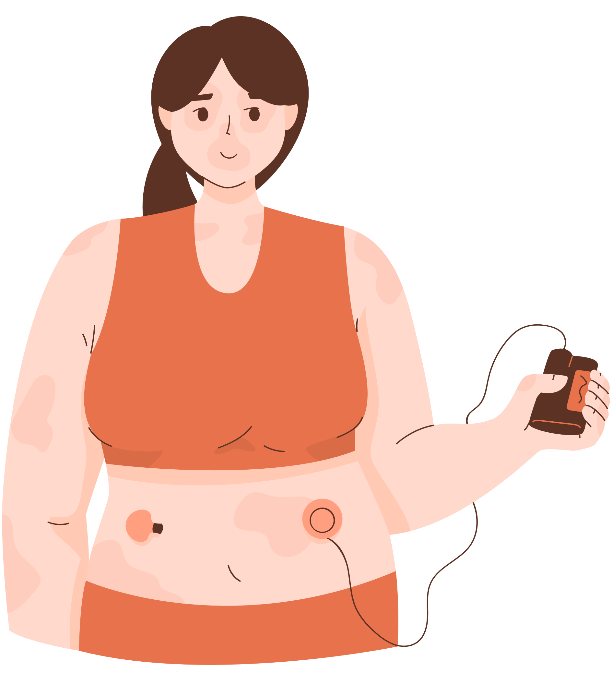

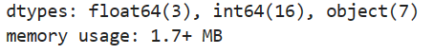
Data Information

Slide 7
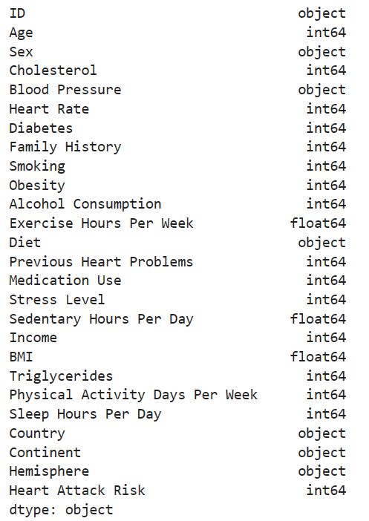
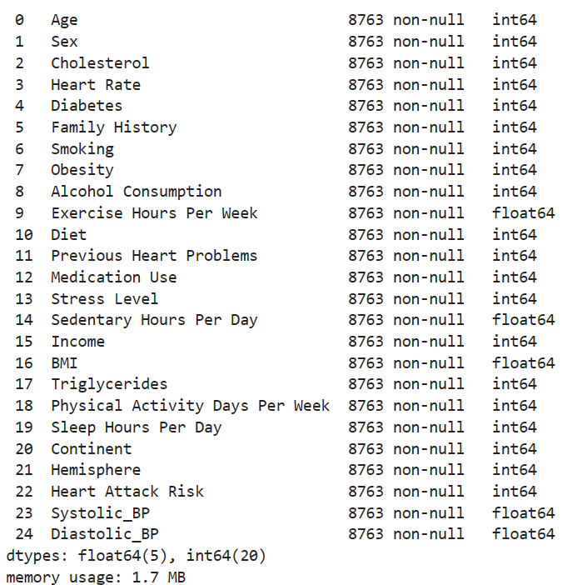
DATA INFOMATION

Slide 8
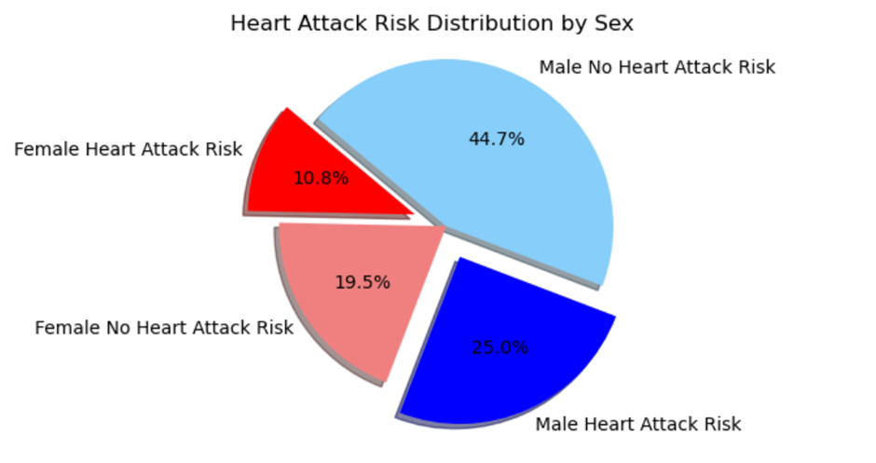

Slide 10


DATA MODELING
1)RANDOM FOREST
2)LOGISTIC REGRESSION
3) DECISION TREE
4) KNN MODEL

Slide 11

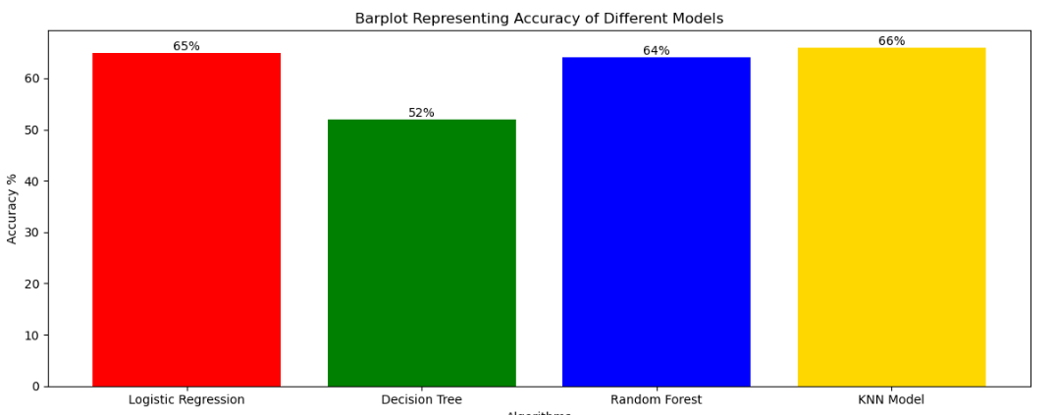

THE EARLY RESULT

Slide 12
WHAT NEXT?
THE CURRENT SET OF MODELS DID NOT PRODUCE THE ANTICIPATED RESULTS. TO ENHANCE ACCURACY, A BROADER SPECTRUM OF MODELS COULD BE EXPLORED, POTENTIALLY INCLUDING ENSEMBLE METHODS OR MORE COMPLEX ALGORITHMS.
ADDITIONALLY, A STRATEGY TO ENHANCE ACCURACY MIGHT INVOLVE PARTITIONING THE DATASET INTO SMALLER SECTIONS FOR IN-DEPTH ANALYSIS OR FOCUSING SOLELY ON CRUCIAL FEATURES IDENTIFIED THROUGH FEATURE IMPORTANCE TECHNIQUES. THIS TARGETED APPROACH COULD LEAD TO MORE REFINED AND EFFECTIVE MODELS

Slide 14
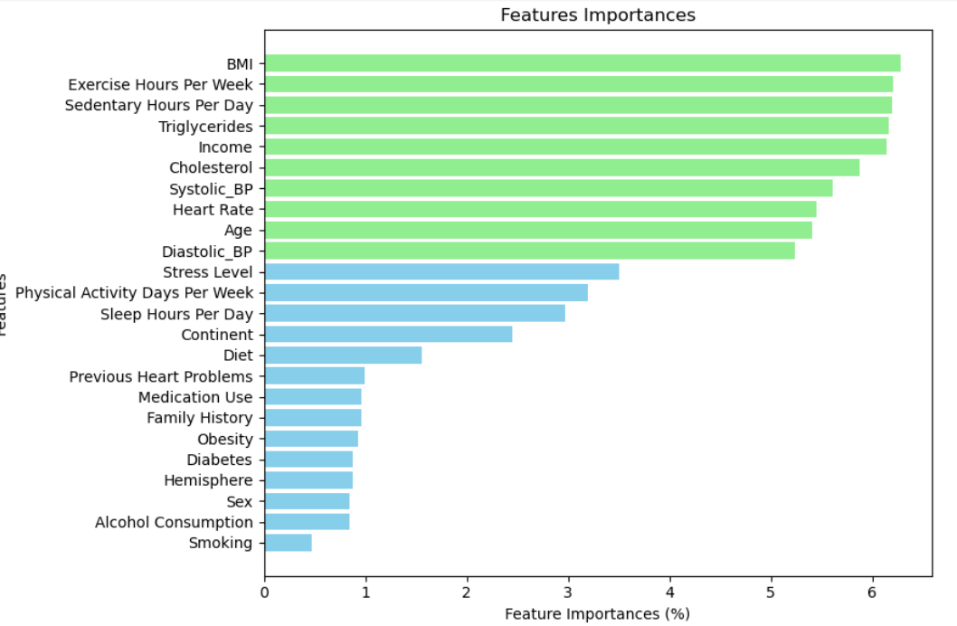
FEATURES IMPORTANT!

Slide 15


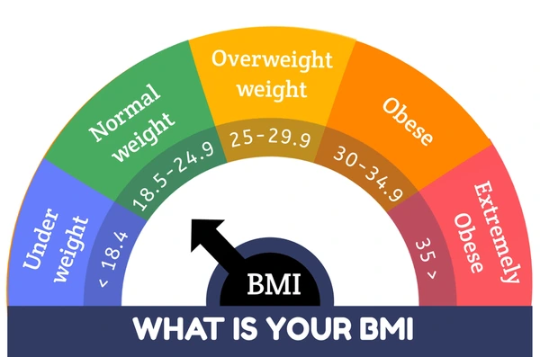
WHAT ABOUT BODY MASS INDEX(BMI)?
A PERSON'S WEIGHT IN KILOGRAMS (OR POUNDS) DIVIDED
BY THE SQUARE OF HEIGHT IN METERS

Slide 16
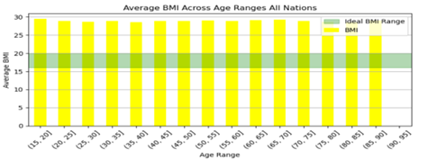
The BMI Situation

Slide 17
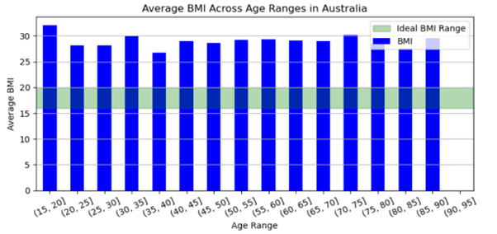

Slide 18
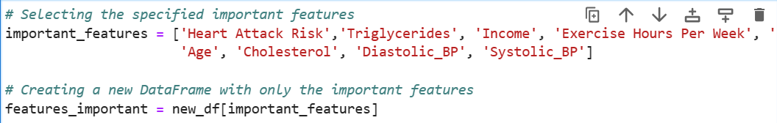
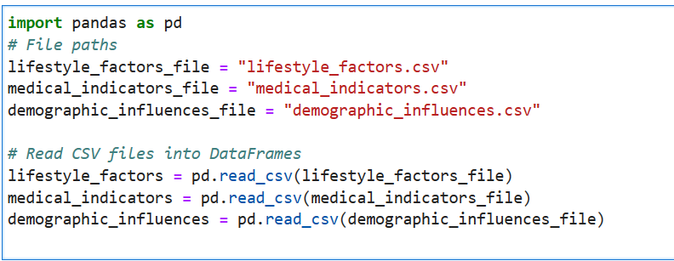
FEATURE IMPORTANT ANALYSIS
Sectional Important

Slide 19
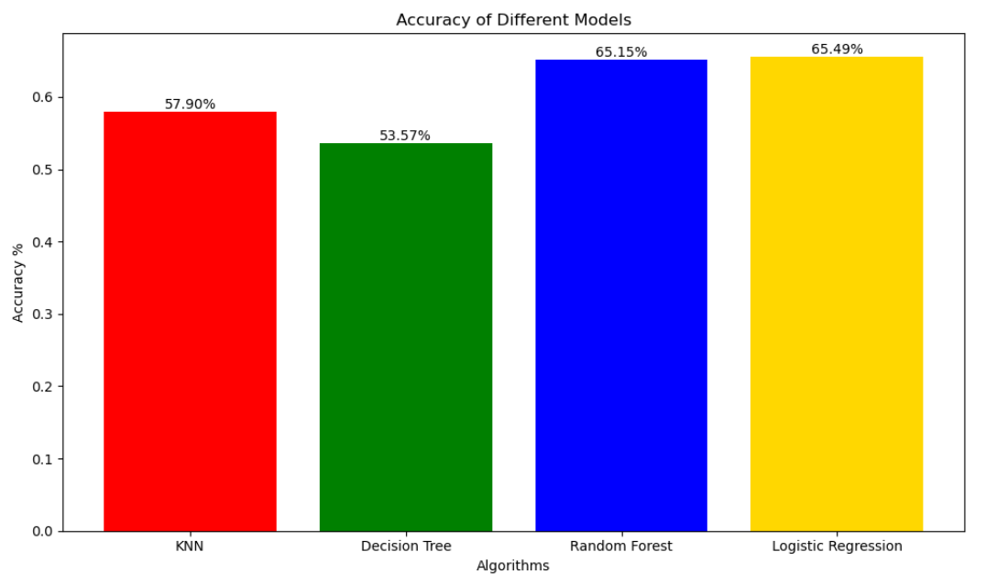

Slide 20
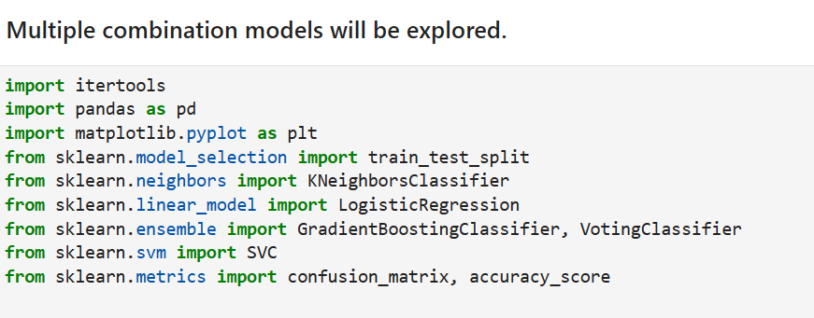

Slide 21
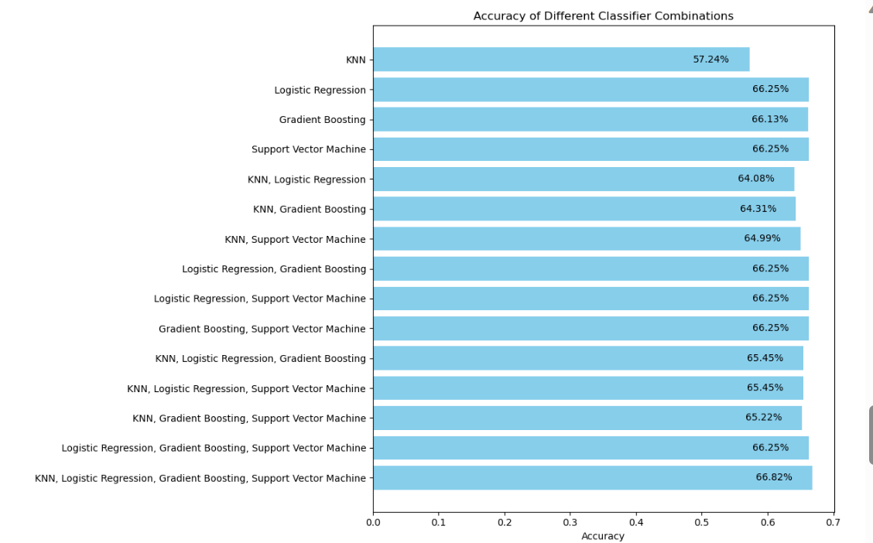

Slide 22
GRADIENT BOOSTING
IS A POWERFUL ENSEMBLE MACHINE LEARNING TECHNIQUE THAT OFTEN PERFORMS WELL IN PREDICTIVE MODELING TASKS.
FLEXIBILITY AND VERSATILITY:
HANDLES VARIOUS DATA TYPES: SUPPORTS DIFFERENT TYPES OF DATA AND CAN HANDLE BOTH NUMERICAL AND CATEGORICAL FEATURES.
FEATURE IMPORTANCE: PROVIDES INSIGHTS INTO FEATURE IMPORTANCE, ALLOWING THE IDENTIFICATION OF CRITICAL FACTORS INFLUENCING PREDICTIONS.

Slide 24
STREAMLET

Slide 25
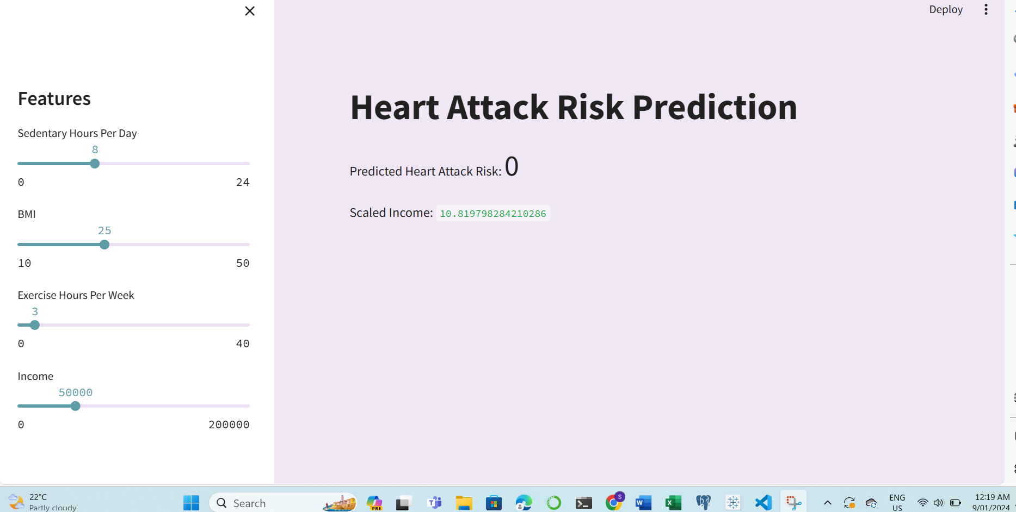

Slide 26

THE END
Any Questions

